Slide 1

Presentation Dynamics through Gesture Control
Team :
Haridharan .K.S
Karthikeyan

Slide 2
1
OUTLINE OF THE PROJECT
Introduction: Providing an overview of the project's objective and potential benefits.
Gesture Recognition: Developing algorithms to accurately detect and classify hand gestures.
Integration with Presentation Software: Creating a software interface to translate recognized gestures into actions within presentation software.
User Interface Design: Designing an intuitive interface for users to configure gesture commands.
Implementation: Detailing the technical setup and hardware/software requirements.
Testing and Evaluation: Conducting rigorous testing to assess system performance and user satisfaction.
Conclusion: Summarizing project outcomes and highlighting future directions.

Slide 3
2
INTRODUCTION
1. Project goal: Introduce intuitive, hands-free slide control with hand gestures.
2. Utilization of computer vision and machine learning for gesture recognition.
3. Recognition of specific hand movements translates to slide navigation commands.
4. Predefined gestures like swiping left/right advance or go back slides.
5. Novel, interactive presentation delivery; replaces remote controls and mouse clicks.

Slide 4
3
PROBLEM STATEMENT
1. Traditional presentation control methods are often not interactive.
2. They can be cumbersome and limit presenter mobility.
3. Lack of engagement with the audience is a concern.
4. There's a need for more intuitive and engaging control approaches.
5. Current methods may hinder interaction with the audience.
First Problem
Limited mobility during presentations.
Second Problem
Potential distractions caused by managing external devices.

Slide 5
4
OBJECTIVES
Objective 1
Objective 2
Designing a user-friendly interface for customization.
Integrating the gesture recognition system with presentation software for seamless control
Objective 3
Implement gesture recognition for diverse commands.

Slide 6
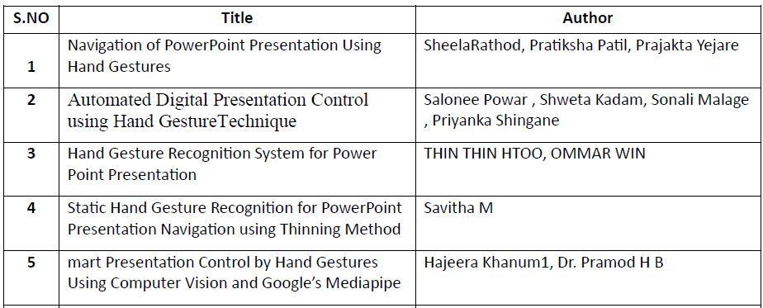
5
LITERARY REVIEW

Slide 7
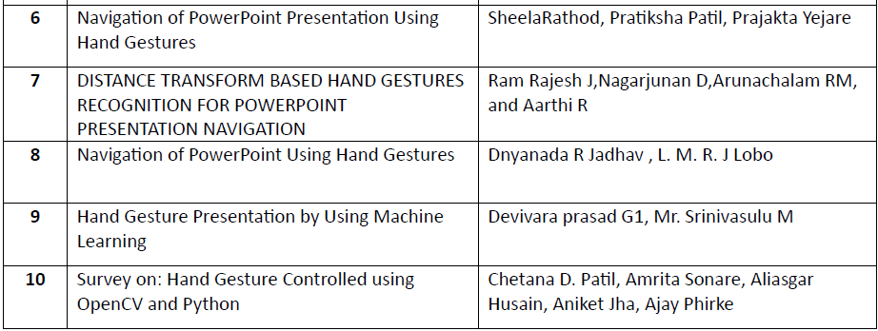
6
LITERARY REVIEW

Slide 8
7
PROPOSED SYSTEM INTRODUCTION
1. Hands-free slide navigation with Gesture-Controlled PowerPoint.
2. Utilizes computer vision and AI for intuitive slide control.
3. Enhances engagement and interactivity in presentations.
4. Simple hand gestures replace traditional input methods.
5. Integration of OpenCV ensures efficiency and user-friendliness.

Slide 9
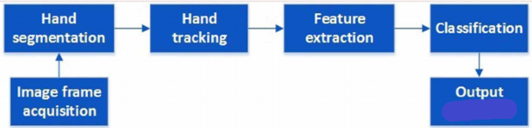
8
PROPOSED SYSTEM DIAGRAM

Slide 10
9
LIST OF MODULES
Hand Tracking Module
Camera Setup
Variables and Parameters
Gesture Detection
Slide Navigation
Annotation
User Interface
Main Loop

Slide 11
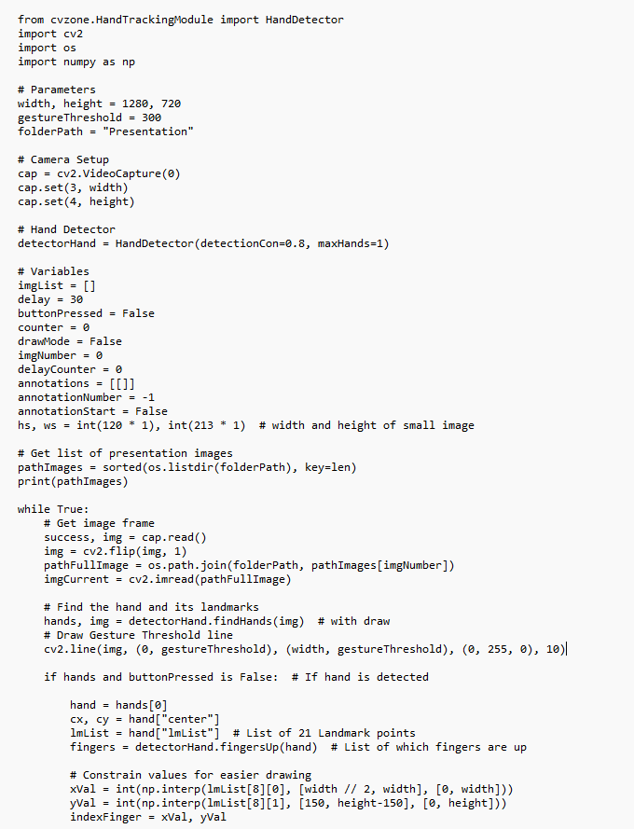
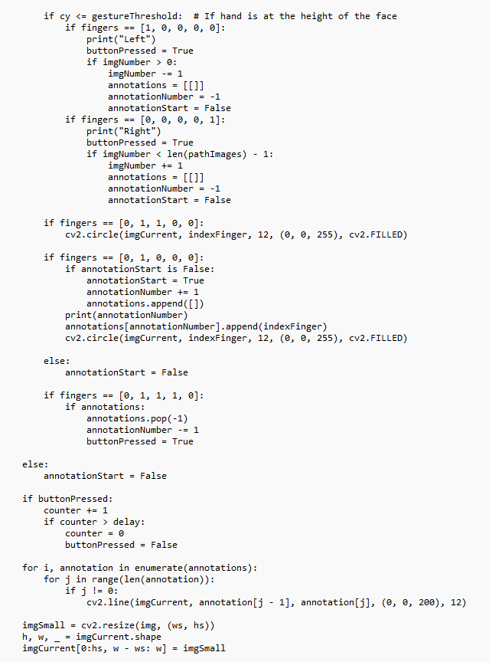
CODE
10

Slide 12
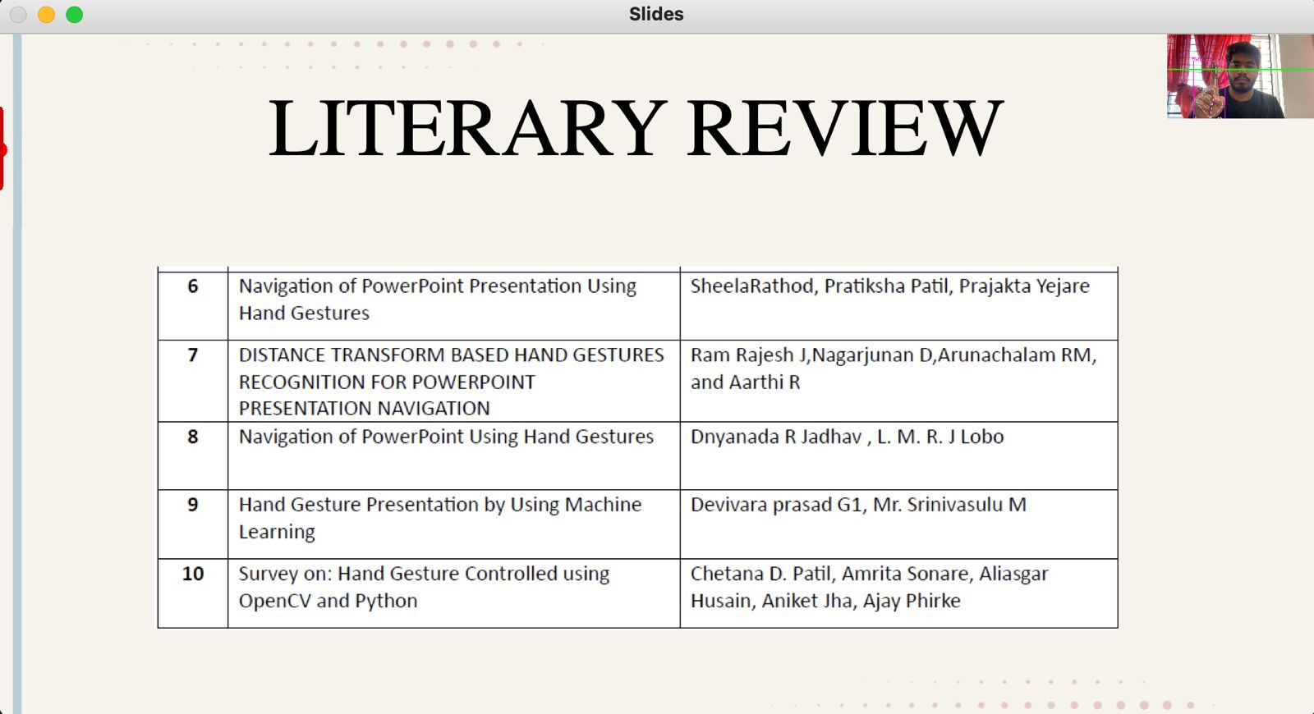
OUTPUT
10

Slide 13
11
REFERENCES
https://www.eurchembull.com/uploads/paper/e1872b82f7272d54308f653ddd1fc741.pdf
https://www.itm-conferences.org/articles/itmconf/pdf/2022/04/itmconf_icacc2022_03031.pdf
https://ijsetr.com/uploads/251346IJSETR16450-43.pdf
https://www.irjet.net/archives/V9/i7/IRJET-V9I7482.pdf
http://data.conferenceworld.in/BVCOE18/65.pdf
https://airccse.org/journal/acij/papers/0512acij04.pdf
https://www.ijsr.net/archive/v4i1/SUB15298.pdf
https://ijirt.org/master/publishedpaper/IJIRT156612_PAPER.pdf

Slide 14
THANK YOU

